Slide 1
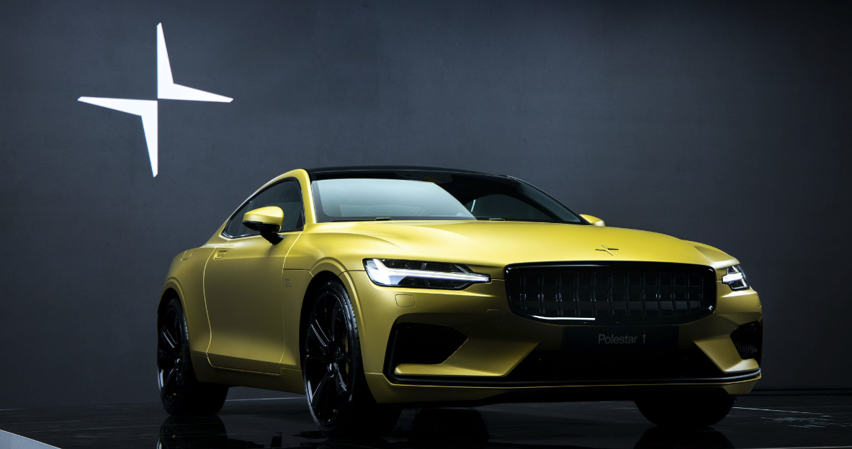
Predicting Polestar Success
Using data analysis of TESLA stock
to determine Polestar success
Notes:
We represent Polestar, an up-and-coming electric vehicle that went public in June 2022.
Proficiency talking points:
Selected topic
Reason why we selected the topic

Slide 2










Overview
Purpose of Project:
Determine whether past stock performance of electric vehicles can predict future stock performance of Polestar.
Questions to Answer:
Can historical stock prices from other electrical vehicles predict growth of Polestar?
How well suited is Polestar to be competitive in the market?
Faraday Future
Team:
Tracey Fitzpatrick
Cheryl Farnsworth
Kelly Nichols
Holly Smith
Notes:
Our team wondered whether historical stock prices from other electric vehicles (EV) could predict growth of this recent addition to the market.
Proficiency talking points:
Selected topic
Reason why we selected the topic
Questions to answer

Slide 3





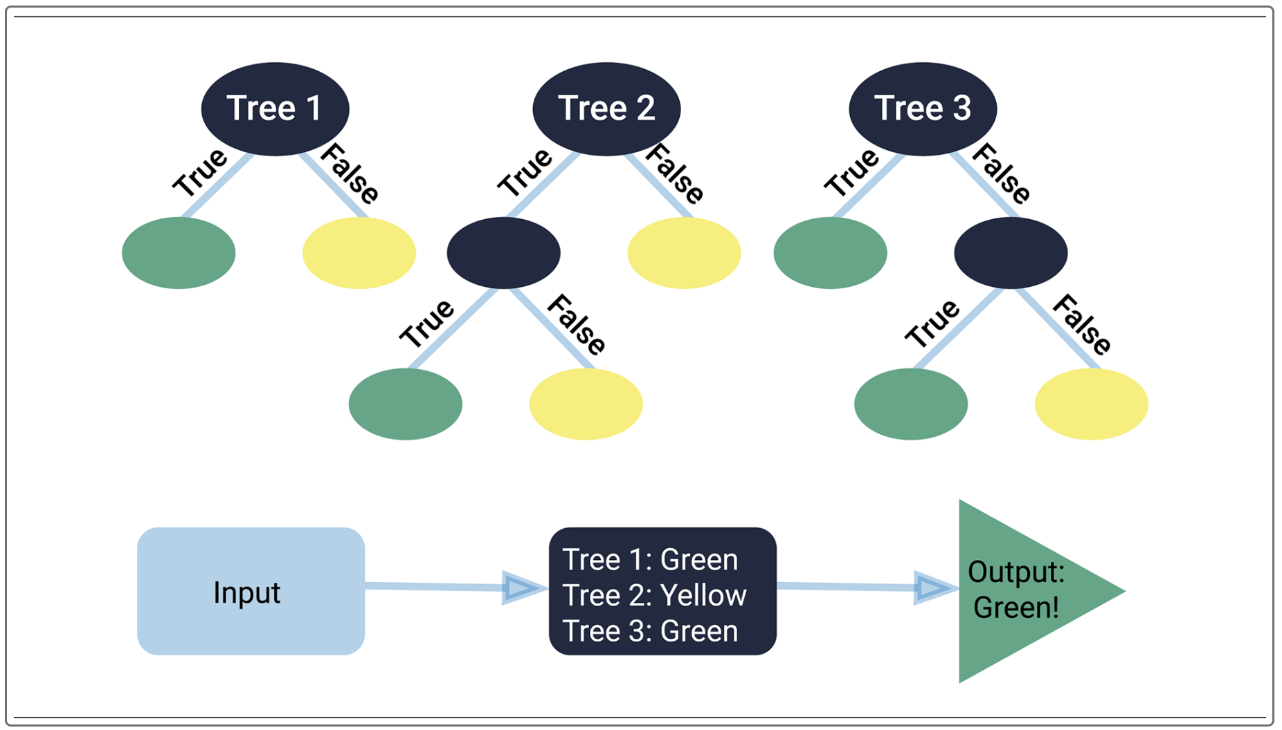


Technologies Used
Random Forest Classifier
Notes:
Is this correct?
Proficiency talking point:
Technologies, languages, tools, and algorithms used throughout the project

Slide 4
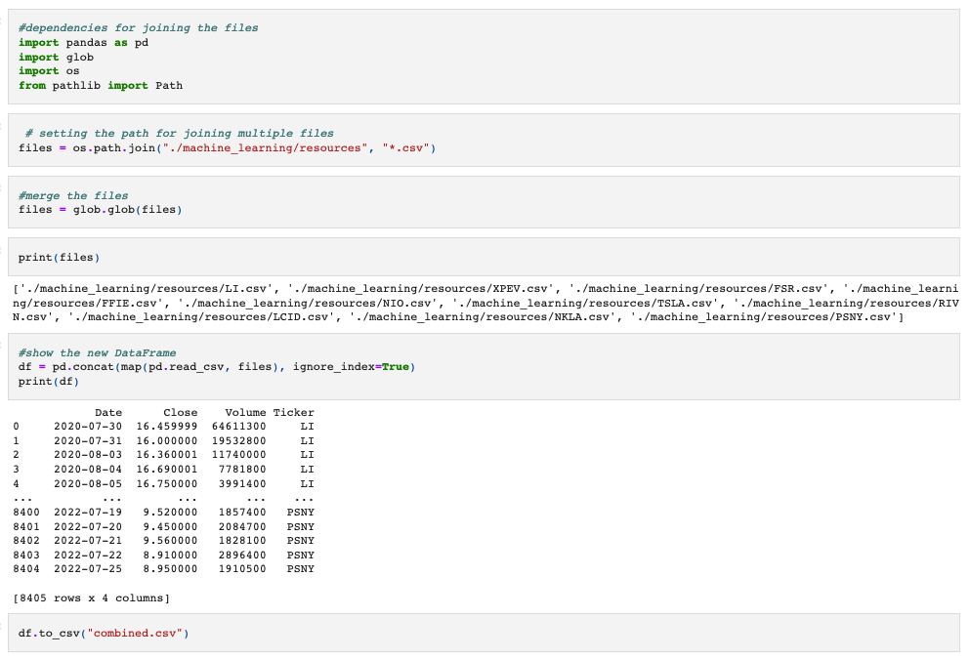
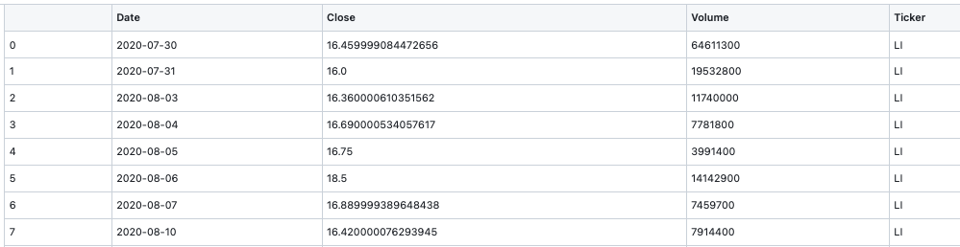
Data Exploration
Notes:
Proficiency talking points:
1) description of source data
2) description of the data exploration phase of the project
We began with creating an ERD to plan our tables but determined joining the tables with SQL would not be beneficial we switched to using Python and Jupyter Notebook

Slide 5
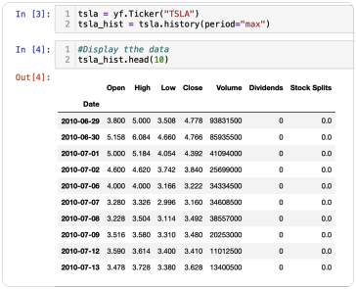
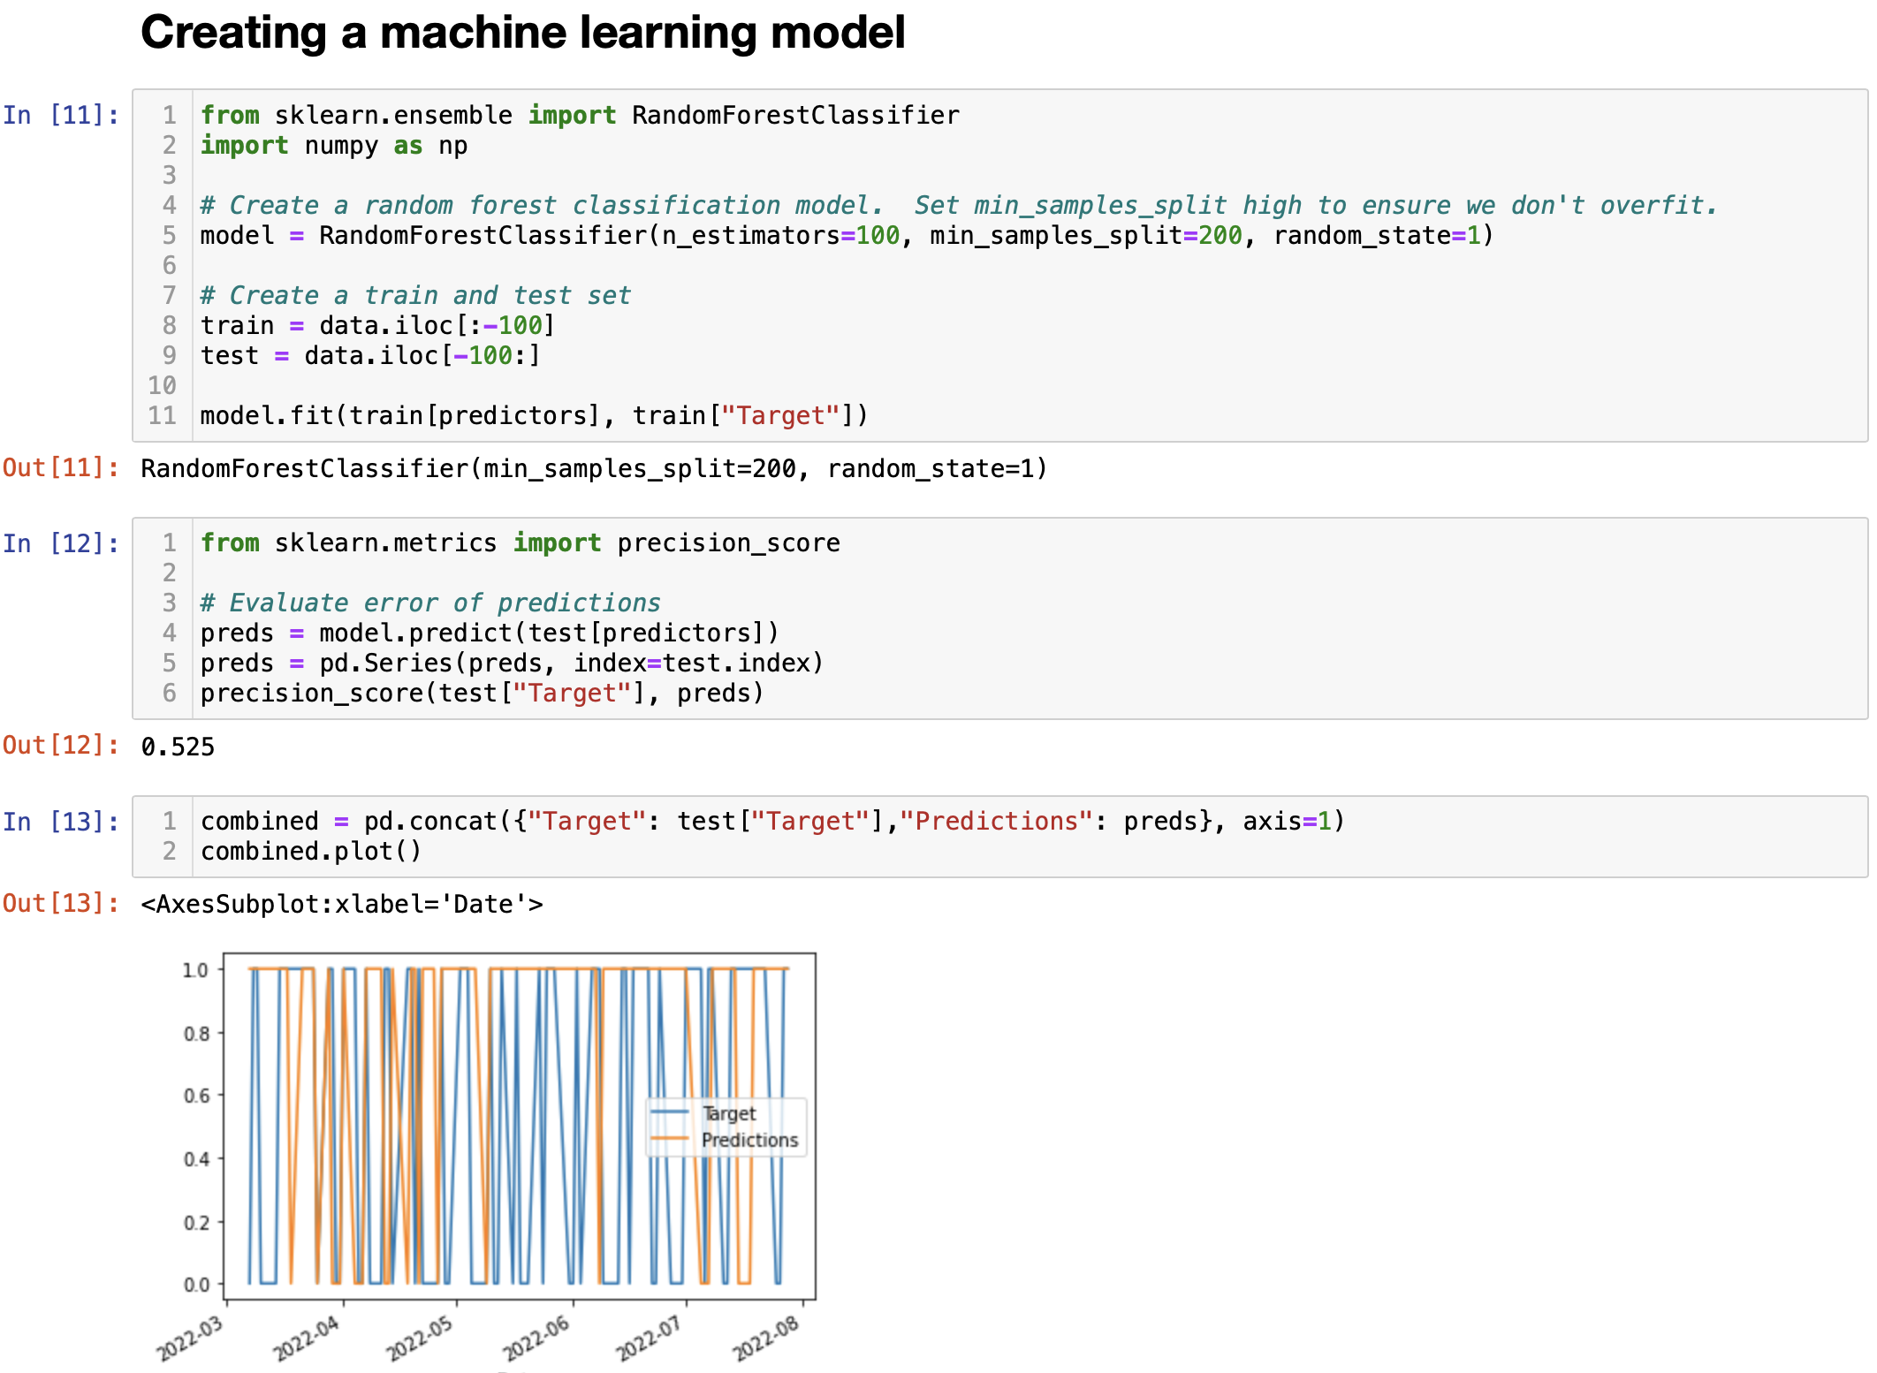
Model Analysis
Our model uses historical pricing and trading volume to predict future share prices for the top 10 electric vehicle companies and potential growth for Polestar.
Step 1: Pull pricing from Yahoo Finance API
Step 2: Predict future pricing for each EV stock
Notes:
We need better pictures – the larger pick is from the README but is not exactly the same as the original. I can’t find Step 1 in the code to re-paste. –Holly
Proficiency talking point:
Description of the analysis phase of the project

Slide 6
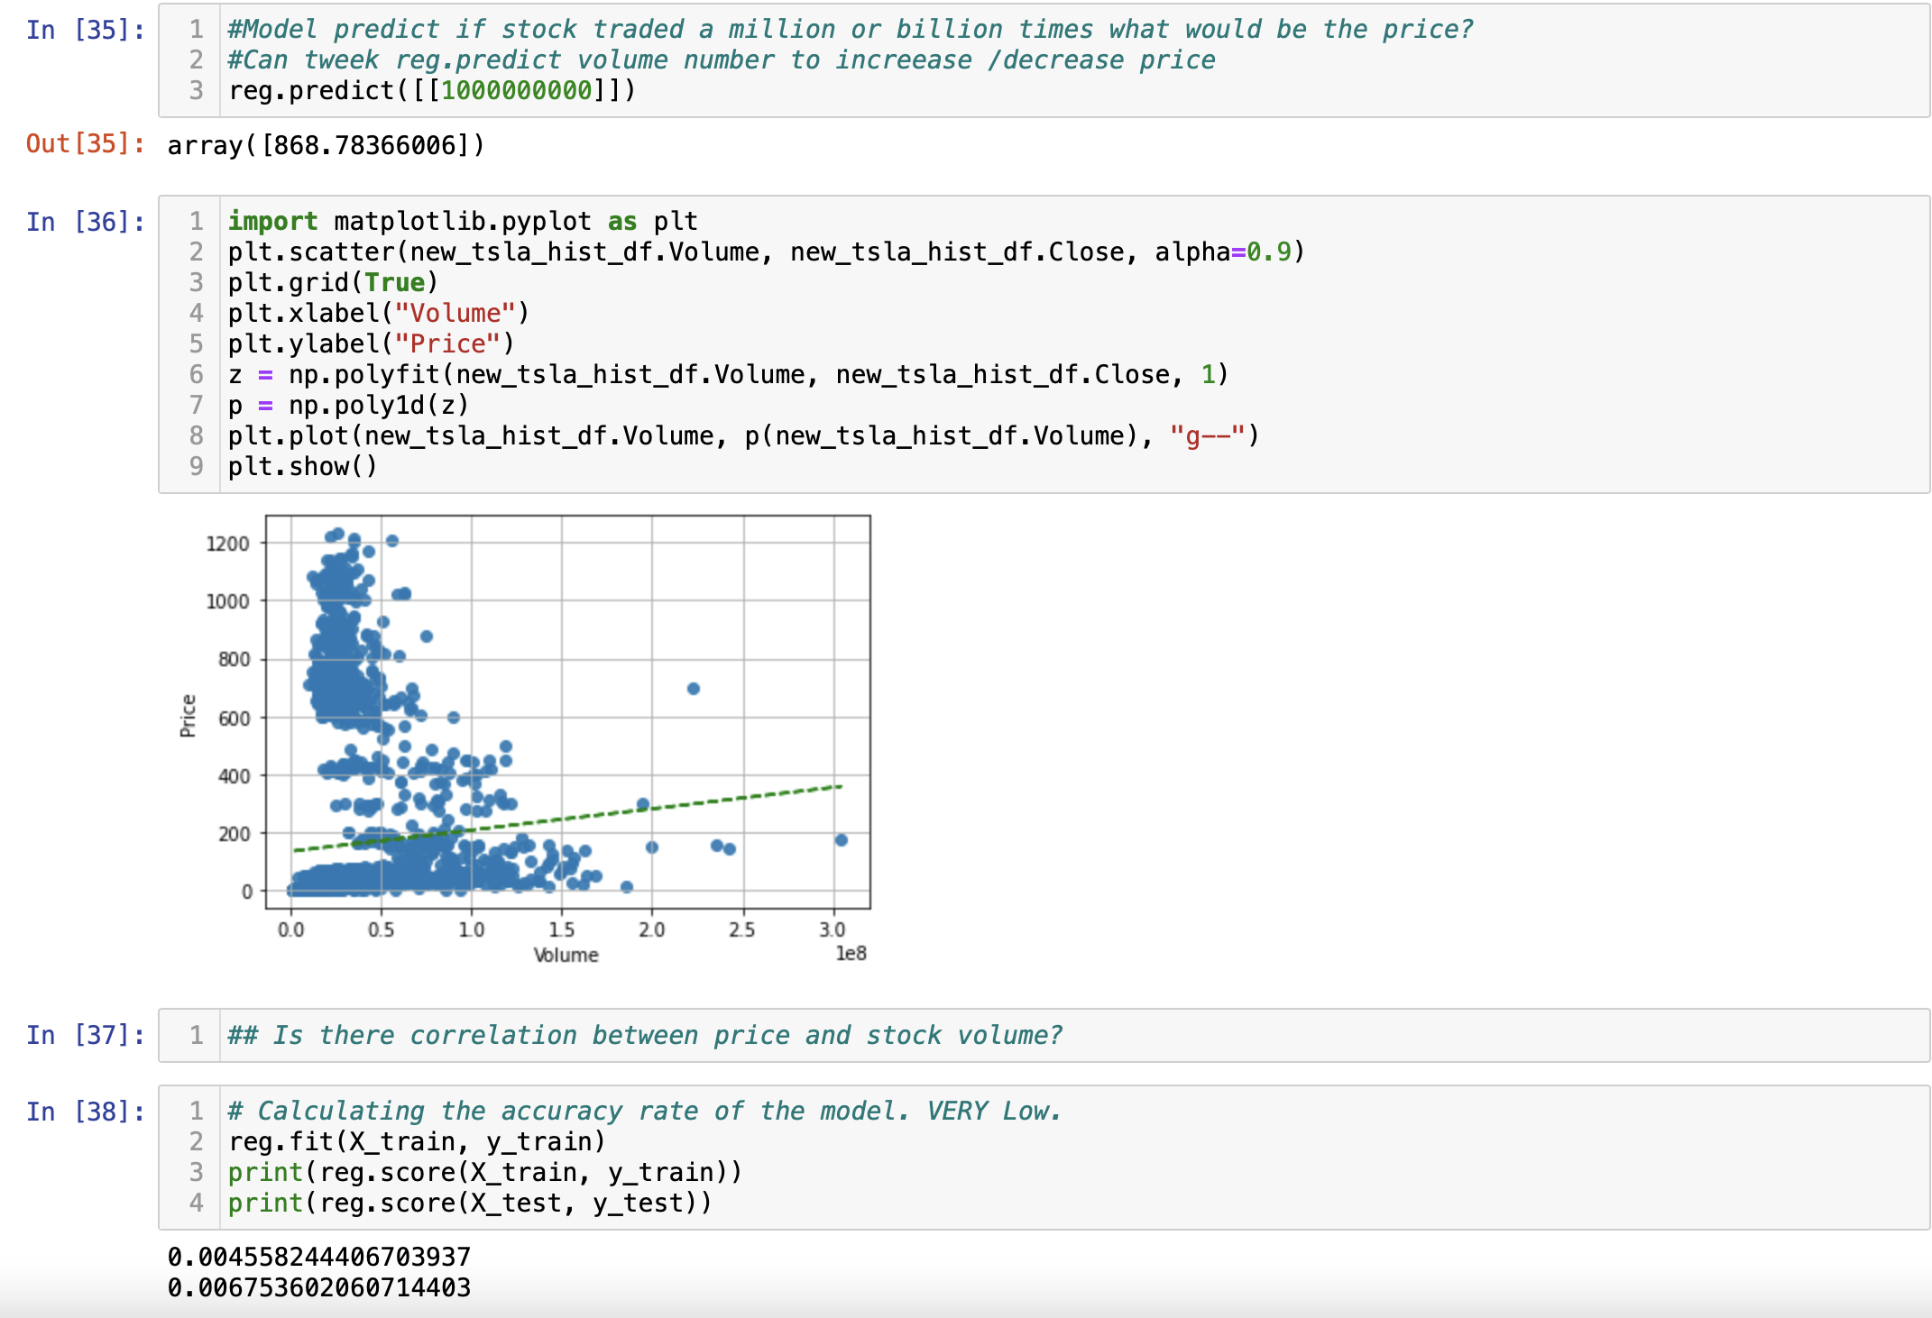
Model Analysis
Step 3: Predict future share price based on trading volume
* There is a correlation between price and volume, but accuracy rate is very low.

Slide 7
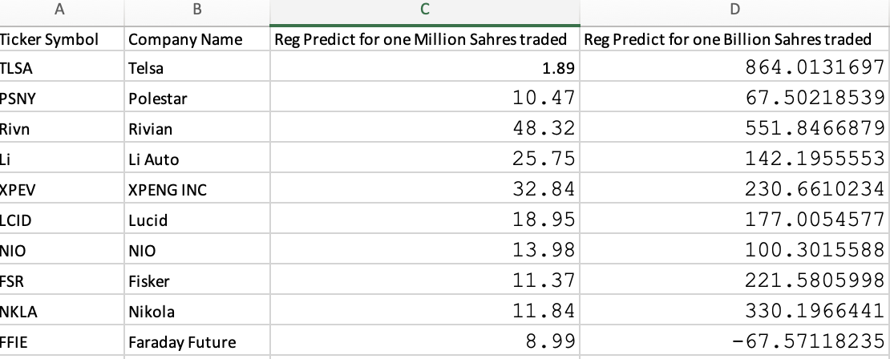
Results
If Polestar is to take on Tesla in the EV market, it will need to expand their business model and invest in marketing to compete with Tesla’s tremendous brand recognition in the industry.
If Polestar continues with the current EV vehicles only model, there is a good chance that share prices will rise to the same level as other similar EV companies.

Slide 8
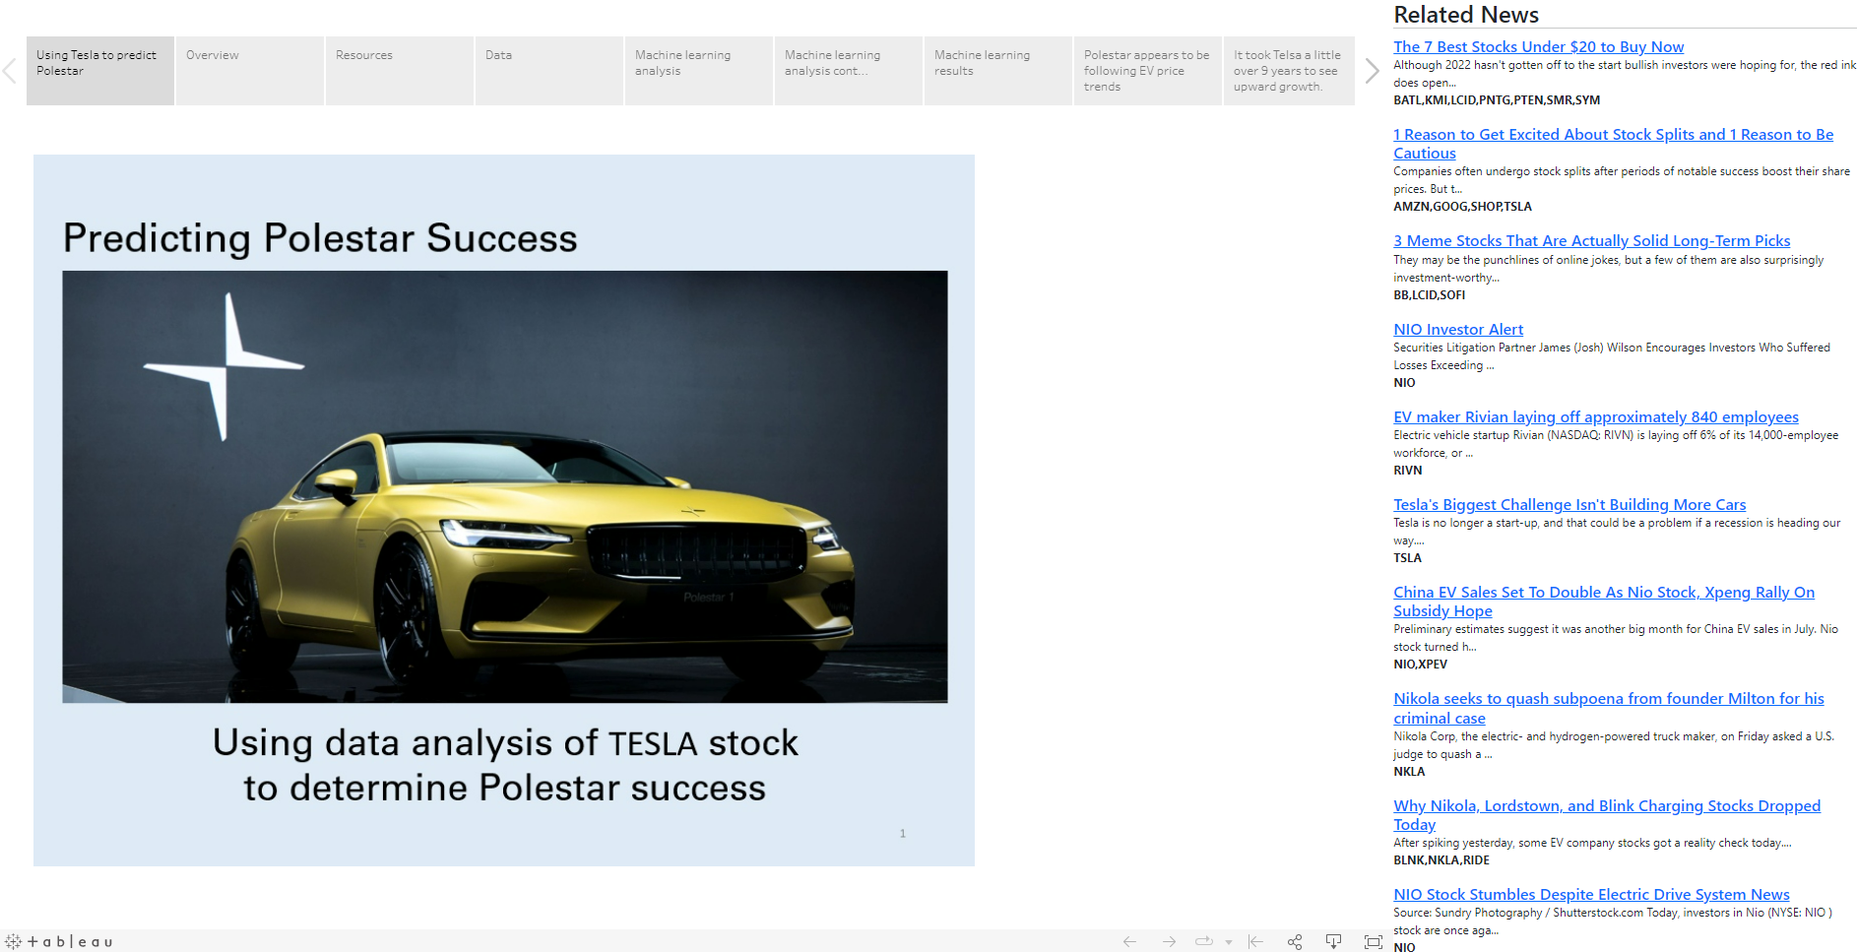
Dashboard
Notes:
As Tracey mentioned there were two outliers – the first is Tesla which as you can see when the data for Tesla is added it totally overshadows all of the other EV companies
The other outlier is Rivin, which went public at $100 per share, increased for 6 days before steadily declining
As you can see from the slide the other EV companies have a similar price as PoleStar, which is highlighted here
Next slide please
This slide shows the price trend for Tesla, as you can see from the trend it took them about 9 years before realizing a steady price increase

Slide 9


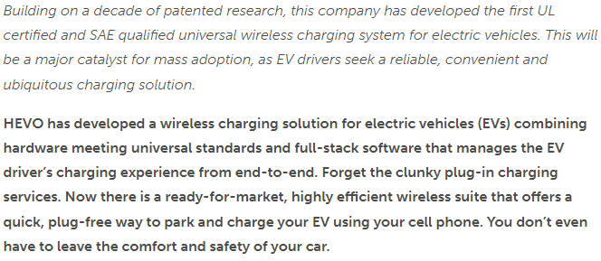
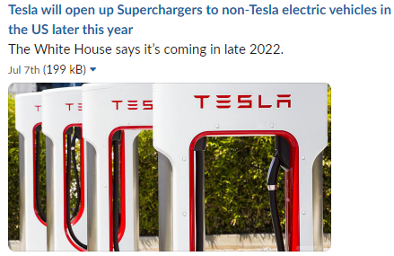

Recommendation
We recommend Polestar use the universal guidelines when building their vehicles. This will benefit their consumers by creating an ease of use for charging and maintenance. This will also be a competitive advantage for them over Tesla, given that Tesla currently has a closed system for both.
EV Future: Public & VC Funded Companies like
Notes:
We’d recommend Polestar use the universal guidelines with building their cars. This will benefit consumers by creating an ease of use for charting. This could also be a competitive advantage for them over Tesla
The global EV market was valued at $371 billion in 2021 and it is expected to quadruple to $1.2 trillion by 2027
The desire is there but the infrastructure is lacking
Tesla recognizes the need to open up their charging stations to non-Tesla drivers and has agreed to do so in 2022
To grow the EV market and increase adoption requires better infrastructure, companies like HEVO are trying to solve that
HEVO expects the EV market with wireless hardware installed to pass 10 million by 2030 and approach 50 million by 2035

Slide 10
What the team would have done differently
As you saw, linear regression and random forest classifier resulted in a lower accuracy than desired.
We recommend using long short-term memory (LSTM) and rerun the model due to LSTM’s ability to remember sequential data which is good to use with stock prediction.
We would also recommend using AutoRegressive Integrated Moving Average (ARIMA) since this method accounts for stochastic (unpredictable) data like stock market prices.
Notes:
As you saw the accuracy using linear regression and random forest classifier was lower than we desired
We’d recommend using long short-term memory and rerun the model. LSTM is good to use with stock predictions because of its ability to remember sequential data
We’d also recommend using AutoRegressive Integrated Moving Average or ARIMA since this method account for stochastic, which is unpredictable data like stock market prices
Next slide please
Thank you for your attention and we’d like to open the floor for questions

Slide 11
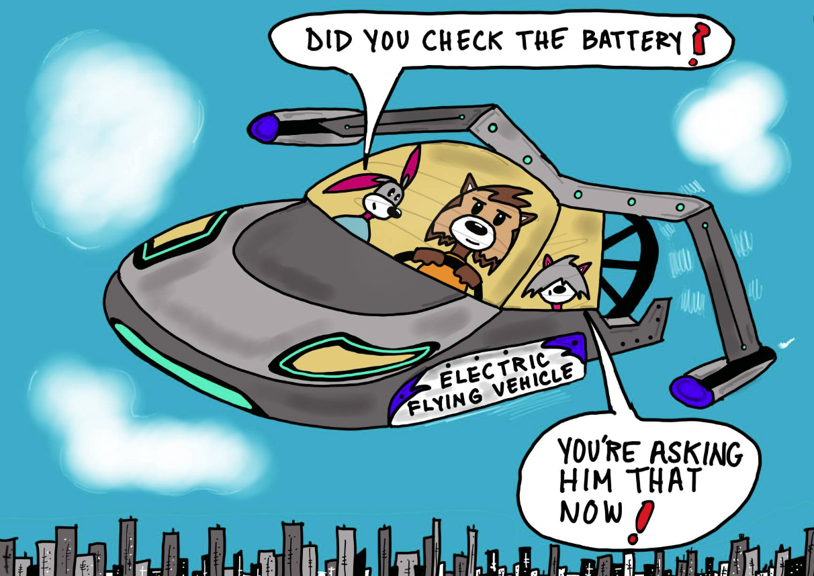
Questions & Answers

